Slide 1

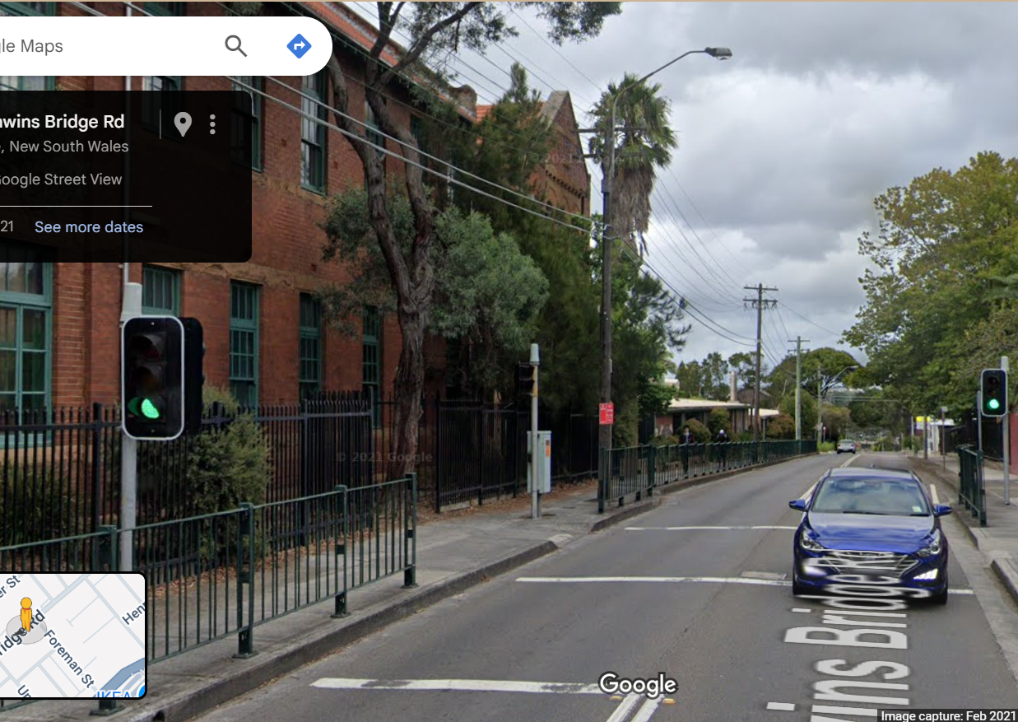
Pi Pico OOP Mini Project
Ben Jones
Tempe High School
Lecture 4
Notes:
Welcome to lecture 4
So far we have created a fully functioning LED_light Class
And a unit test for that Class

Slide 2

Simple Open Loop Control System
Traffic Lights remain green until pressed (idle state).
Button pressed triggers state change.
Lights rotate through a pattern based on time.
System returns to idle state
Notes:
Now we are going to develop a Class for the pedestrian button
This button will initiate the state change

Slide 3
Today
Implement a basic button Class
Create an interrupt and debounce the button
Unit test the pedestrian button
Notes:
Today we will
implement a basic button Class specific for our system
Create an interrupt to listen for a button event
Debounce the button
We will then develop a unit test for our Class

Slide 4

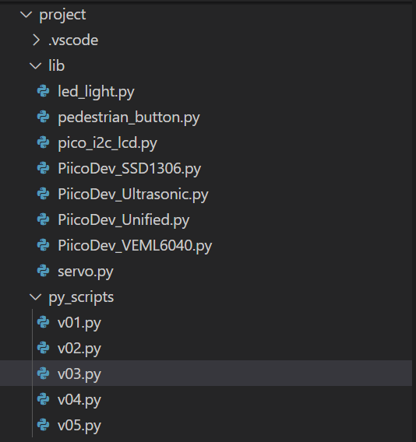
Create new files
v05.py in project\py_scripts\
pedestrian_button.py in project\lib\
Notes:
It is good practice to create new version for each feature.
This documents our development progress
And provides unit tests, that can be easily re-used in the future
Start by creating a v05 .py in py scripts where you will
implement your unit test
Then create a pedestrian button .py in lib folder
Where you will abstract your Class

Slide 5
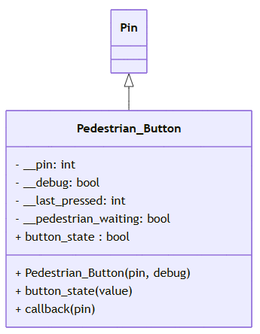
UML
Notes:
This is the UML for the Class we will develop today
This Class inherits the PIN Super Class
This Class does not have any polymorphism

Slide 6
Pedestrian_Button Imports
from machine import Pin
from time import ticks_ms, ticks_diff
Notes:
These are the imports we will need

Slide 7
Pedestrian_Button Class Initialiser & Attributes
Class Pedestrian_Button(Pin):
# Sub Class inherits the Super 'Pin' Class
def __init__(self, pin, debug):
super().__init__(pin, Pin.IN, Pin.PULL_DOWN)
self.__debug = debug
self.__pin = pin
self.__last_pressed = 0 # Track the last time the button was pressed
self.__pedestrian_waiting = False
self.button_state
Notes:
The Class initialiser calls the super initialiser of the Super Class
Then stores the attributes as encapsulated variables
The self.button_state attribute is a required attribute
for the setters and getters we will develop

Slide 8
Pedestrian_Button “Getter”
@property
def button_state(self):
if self.__debug:
print(f"Button connected to Pin {self.__pin} is {'WAITING' if self.__pedestrian_waiting else 'NOT WAITING'}")
return self.__pedestrian_waiting
Notes:
Because of our system design this getter is different to
what would normally be implemented for a button.
We are not getting if the button is it currently being pressed,
we are getting has it been pressed which is
held in the state of __predestrian_waiting

Slide 9
Pedestrian_Button “Setter”
@button_state.setter
def button_state(self, value):
self.__pedestrian_waiting = value
if self.__debug:
print(f"Button state on Pin {self.__pin} set to {value}")
Notes:
Normally a button would not require a setter,
but in our case, we need to reset the __predestrian_waiting state
once the pedestrian walk state has ended.
Ready for the next pedestrian.

Slide 10
Pedestrian_Button Interrupt
Class Pedestrian_Button(Pin):
# Sub Class inherits the Super 'Pin' Class
def __init__(self, pin, debug):
…
# Set up interrupt on rising edge
self.irq(trigger=Pin.IRQ_RISING, handler=self.callback)
Notes:
We can keep checking the button has been pressed,
But that is a waste of resources.
So we will implement an interrupt.
An interrupt is when the hardware is constantly listening
for a state change. One that state change it will
Call a handler (method)
In this case the interrupt is waiting for the current to rise
When it does it will call the self.callback() method.

Slide 11
Pedestrian_Button Interrupt Callback Method
def callback(self, pin):
current_time = ticks_ms() # Get the current time in milliseconds
if (ticks_diff(current_time, self.__last_pressed) > 200): # 200ms debounce delay
self.__last_pressed = current_time
self.__pedestrian_waiting = True
if self.__debug:
print(f"Button pressed on Pin {self.__pin} at {current_time}ms")
Notes:
This is the implementation for the self.callback()
We also want to debounce the button.
Button bouncing refers to the noise that happens
when a mechanical button is opening and closing
At the point of contact where is no clean connection
But noise
We want to ignore the noise and only return a state change
when the button has been cleanly pressed for over 200ms

Slide 12
Add documentation to your Class
Class LedPico:
"""
Simple Class to turn an LED on or off on a Raspberry Pi Pico.
Args:
pin (int): GPIO pin number for the LED.
Example:
led = LedPico(25) # Onboard LED
led.set(True) # Turn on
led.set(False) # Turn off
"""
def __init__(self, pin):
from machine import Pin
self.led = Pin(pin, Pin.OUT)
def set(self, state: bool):
"""
Set the LED on or off.
Args:
state (bool): True to turn on, False to turn off.
"""
self.led.value(1 if state else 0)
Class-level docstring: Briefly describes what the Class represents and lists its attributes and methods.
Constructor docstring: Explains what parameters are needed to create an instance.
Method docstrings: Describe what each method does and what parameters it takes.
Notes:
Using this example as a template write developer documentation
For your pedestrian button Class
Your documentation should describe the purpose/why
not the implementation/how
“Set the LED on or off” is good documentation
As it describes what the method does
Compared to
“Set pin high or low” is poor documentation
As it just says how it does it and does give any context

Slide 13
Unit Test the Pedestrian_Button Class
Your unit test should test all methods, where possible, because it involves a physical button you should design a manual test.
Pause the video, design your unit test.
Notes:
Lastly your task is to now unit test your button.
Because it is a physical button it does require
some manual intervention to validate the test.
Press pause and design your unit test in v05.py

